Slide 1
Analytics Insights
Customer Relationship Management (CRM) Data Analysis
Muhammad Abdulmateen
Wednesday, June 19, 2024

Slide 2
Agenda
Introduction
Data Preprocessing and Transformation
Exploratory Data Analysis
Problem Statement and Objectives
Analytical Solution
Conclusion and Recommendation

Slide 3
Introduction
Techx Emporium is a establishment that deals with the sales of high tech products to companies.
There are a total of 7 different products which are sold.
They provided a dataset with over 8000 records of transactions.
This project aims to analyze the dataset, come up with a problem statement, and proffer viable solutions to the problem.

Slide 4
Data Preprocessing and Transformation
Data Quality Assessment
The project consists of four data tables:
Accounts Table: Provides data on the different customers,
Products Table: Provides data on the products sold,
Sales Teams Table: Provides data on the sales teams including the sales agent as well as their managers, and
Sales Pipeline Table: Provides the record of the transactions.
All four tables were thoroughly and transformed in SQL before merging for the analysis.

Slide 5
Data Preprocessing and Transformation
Data Quality Assessment
The data quality issues found in the datasets were:
Quality Dimension | Accuracy | Completeness | Validity
Accounts | Sector: Inaccuracy
Products | Products: Inaccuracy
Sales Pipeline |  | Account, Close date, Engage date, Close value: Blanks | Engage date, Close date: Format

Slide 6
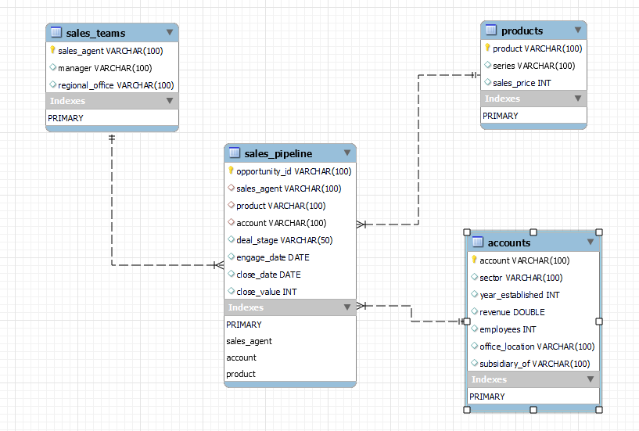
Data Preprocessing and Transformation
Data Model
The figure shows the relationships between the different data tables.
The database represents a star schema with the sales pipeline table being the fact table to which all the other dimension tables are connected to.

Slide 7
Exploratory Data Analysis
Transactions and Revenue
8800 total transactions with 48% successful deals.
Peak transaction period occurred in July.
Total revenue of $10,005,534.
There was a steady increase in revenue from October 2016 to March 2017, and a rapid decline from October 2017 to December 2017.

Slide 8
Exploratory Data Analysis
Deal Stages
There have been a total of 4238 successful transactions representing 48% of total transactions.
The deal stage with the lowest number of transactions is the prospecting stage with only 500 deals.

Slide 9
Exploratory Data Analysis
Product Analysis
The highest selling product is the GTX basic with 915 successful deals.
The lowest selling is the GTX 500 with only 15 successful transactions.
The product generating the most revenue is the GTX PRO with over $3m.
The product with the lowest revenue is the MG Special with only about $40k.

Slide 10
Exploratory Data Analysis
Revenue by Region and Sector
Revenue generated across all three regions are above $3m.
The west generates the highest revenue of about $3.6m.
The top 3 sectors with the most revenue are the Retail, Technology, and Medical sectors each generating over $1.3m.
The bottom 3 sectors with the least revenue are the Employment, Services, and Telecommunications sectors each generating below $700k.
The Employment and Services sectors generate less than a third of the Retails sector revenue

Slide 11
Exploratory Data Analysis
Sales Agents
The best performing sales agent is Darcel Schlecht;
They generated over $1m in revenue,
with 747 total deals and 349 successful deals.
Top Performing Sales Agents

Slide 12
Problem Statement and Objectives
Problem Statement
The exploratory data analytics reveal that only about 48% of total deals were successful with about another 28% lost potentially indicating an inefficiency in the transaction process.
Objective
Identify factors contributing to low deal success rate.
Propose recommendations to improve the deal success rate.

Slide 13
Analytical Solution
Product Sales
Product | Total Revenue | Successful Deals | Average Price
GTX PRO | $3,510,578 | 729 | $4815.61
GTX Plus Pro | $2,629,651 | 479 | $5489.88
MG Advanced | $2,216,387 | 654 | $3388.97
GTX Plus Basic | $705,275 | 653 | $1080.05
GTX Basic | $499,263 | 915 | $545.64
GTK 500 | $400,612 | 15 | $26707.47
MG Special | $43,768 | 793 | $55.19
GTX PRO generates the most revenue of $3,510,578 with its relatively high price and successful transactions.
MG Special is the second highest selling product but generates the lowest total revenue of $43,768 due to its very low price.

Slide 14
Analytical Solution
Regional Sales
The Central performed best with the most number of total and successful transactions.
The East ranked in the last place with the lowest number of total and successful transactions.
There is 35% and 28% difference in the total and successful transactions respectively between the top Central region and the bottom East region.

Slide 15
Analytical Solution
Sales Agent
It is observed that there is a wide disparity in the transaction volumes of the top 3 and bottom 3 sales agents.
The top 3 sales agent are consistently engaged in multiple transactions monthly while the bottom 3 show significantly fewer transactions.
There are 5 sales agents that have not engaged in any transactions

Slide 16
Analytical Solution
Managers Ranking
Manager | Revenue | Total Transactions | Weighted Average
Cara Losch | 5 | 6 | 5.4
Celia Rouche | 4 | 5 | 4.4
Dustin Brinkmann | 6 | 3 | 4.8
Melvin Marxen | 1 | 1 | 1
Rocco Neubert | 3 | 4 | 3.4
Summer Sewald | 2 | 2 | 2
The best performing manager is Melvin Marxen.
The worst performing manager is Cara Losch.

Slide 17
Conclusion and Recommendation
Conclusions
The prices of the products are a huge factor in their demand and consequently revenue generation
The low price of MG Special contributes heavily to its low revenue generation.
The high price of the GTK 500 might be a major contributor to its low sales.
The Central region is performs very well compared to the other regions.
There are significant discrepancies in the performance of the sales agents.
There is a massive underperformance in the Employment and Services sectors.

Slide 18
Conclusion and Recommendation
Recommendations
The price of MG Special should be increased to capitalize on its high demand.
The price of the GTK 500 should be lowered to encourage customers to purchase them.
The least performing sales agents should either be incentivized to improve or replaced.
There should be an investigation into why some of the sales agents have not engaged in any deal.
There should be increased efforts in the East region to boost their performance.
There should be increased efforts in the Employment and Services sectors to boost their performance.

Slide 19
Thank you

